Slide 1
Intro to Color
Mr Mack 2021

Slide 2
Overview
In this learning activity students add color to any of their previous designs. They learn to apply the background(), fill(), and stroke() functions (used in scales of gray until now), to define colors and add transparency. The RGB (red, green, blue) color model is applied.
Students apply the programming concepts they learned in the previous unit (variables, randomness) to color manipulation, defining color ranges and palettes.

Slide 3
Objectives
Students will be able to:
Describe the process by which computers mix colors (additive mixing)
Use fill() to change the color of shapes in RGB color mode.

Slide 4
RGB Color and Additive Mixing
So far, fill has been used to accept only one number, and it's created greyscale drawings. In reality, fill accepts three values in a default color mode called RGB - or Red, Green, Blue.
We can use these colors to change elements of our drawing, however, we need to be aware that they work differently than colors we may have used in art classes. If you run this project, you will see three circles in red, green, and blue that overlap and mix - yet this mixing is probably different than what you are used to.

Slide 5
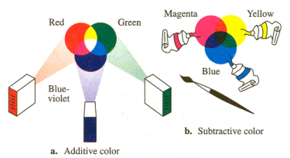
RGB Color and Additive Mixing
This is because computers use additive mixing, a process that adds different colored lights to create color. Traditional media uses subtractive mixing, which absorbs different colored lights to create color. (an in-depth explanation of the RGB color model can be found here)

Slide 6

RGB Color and Additive Mixing
In our mixing program, we have also adjusted the transparency (the optional fourth value in fill) to allow colors to mix. Its range is 0 (transparent: not visible) to 255 (opaque). You will notice that when we want to change fill, we call a new color before the shape we want to change. Because the draw function is a repeated loop, this presents one color from being applied to every shape.

Slide 7
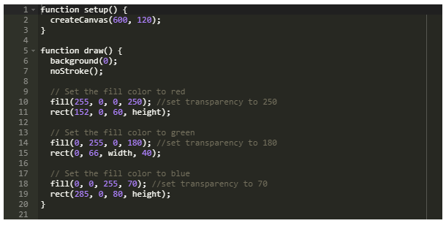
RGB Color and Additive Mixing

Slide 8

RGB Color and Additive Mixing
Try adding colors to a previous sketch. This page is useful for picking colors. For color palette inspiration, you can take a look at this one and this one. Here is our happy face, in color:

Slide 9
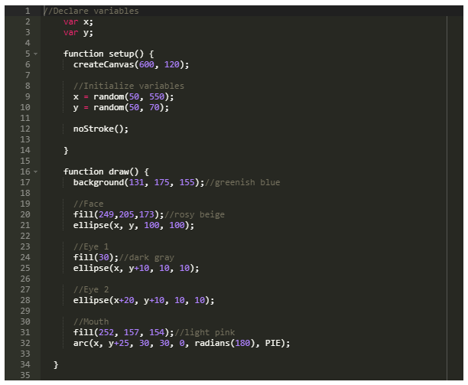
RGB Color and Additive Mixing

Slide 10

RGB Color and Additive Mixing
Here it is with a more vibrant color palette and a thicker stroke:

Slide 11
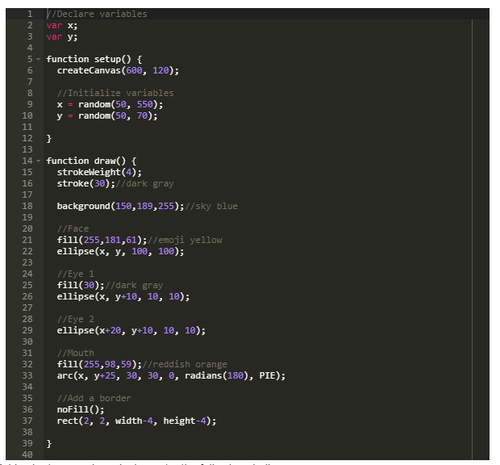
RGB Color and Additive Mixing

Slide 12
Practice
Open this sample code.
Set a different fill() and stroke() for each ellipse
Add color to a previous design or try the following challenge:

